Slide 1
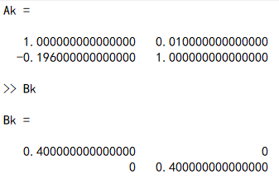
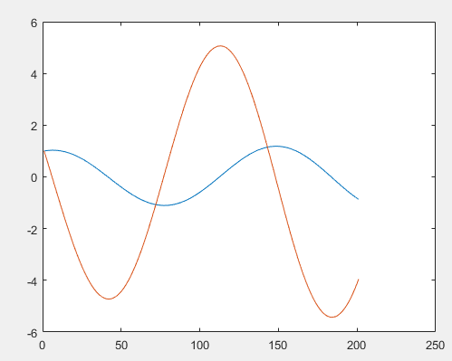
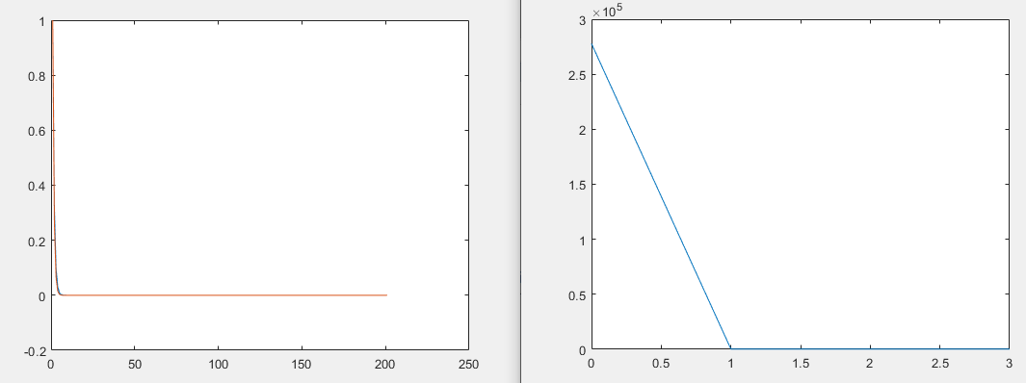
Ilqr+least square central difference sysid+LTI system
Weiwei li 2004
Initial trajectory
Ilqr trajectory
Ilqr cost

Slide 2
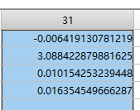
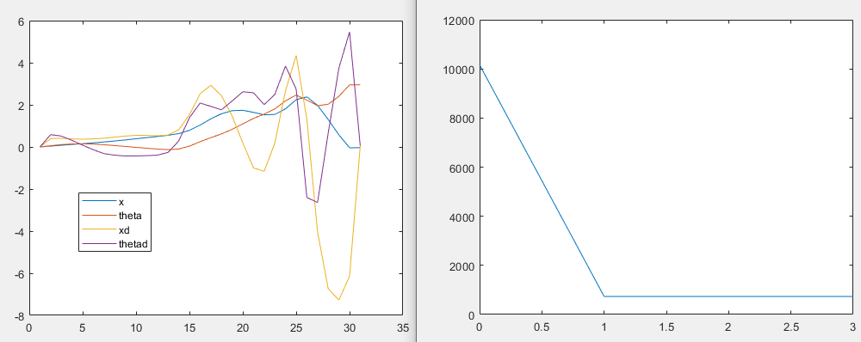
Ilqr+ Ltv cartpole + LSCD

Slide 3
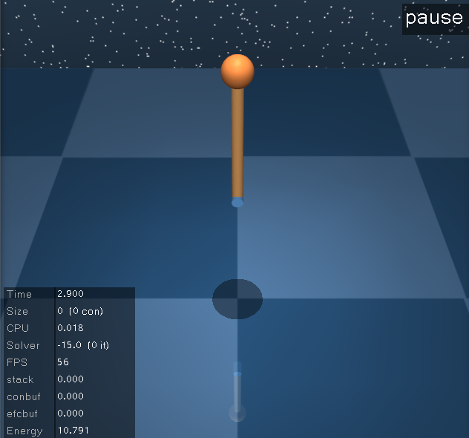
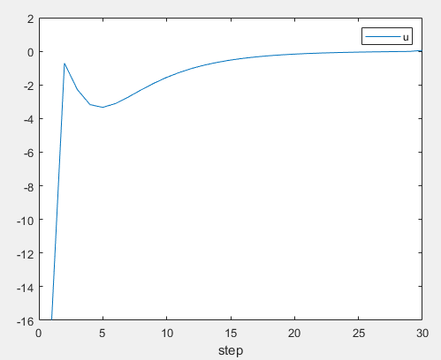
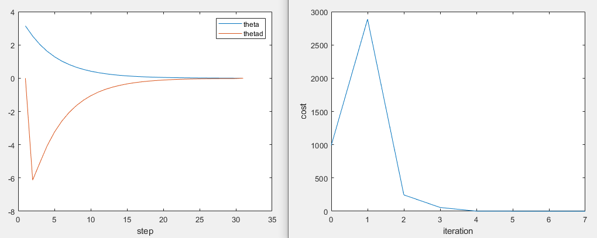
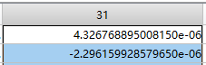
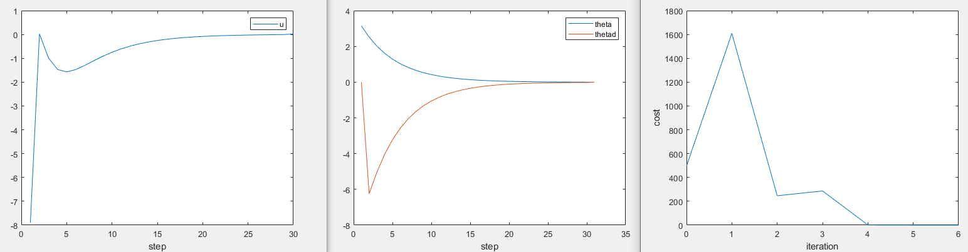
Ilqr+ pendulum + LSCD
Same cost as in Weiwei li paper
Add x-x_target to incremental cost, Q,R same

Slide 4
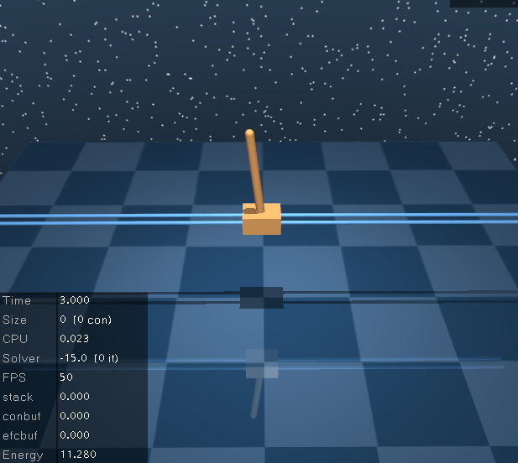
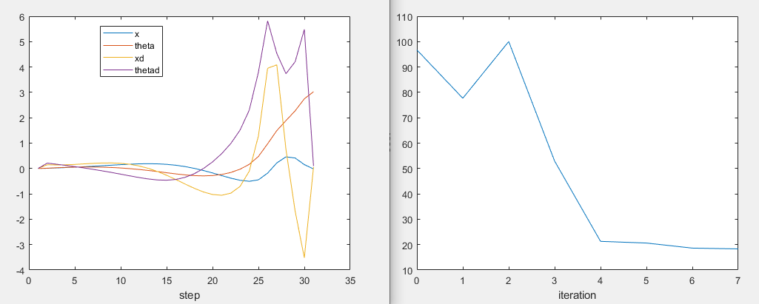
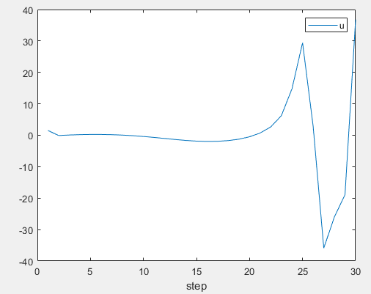
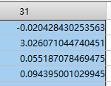
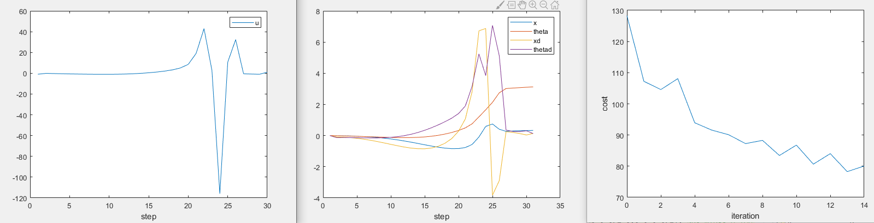
Ilqr+ cartpole + LSCD
Same cost as in Weiwei li paper
Add x-x_target to incremental cost

Slide 5
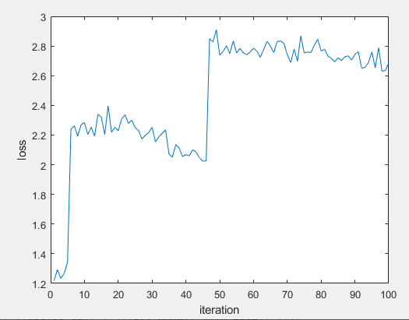
Spsa id

Slide 6
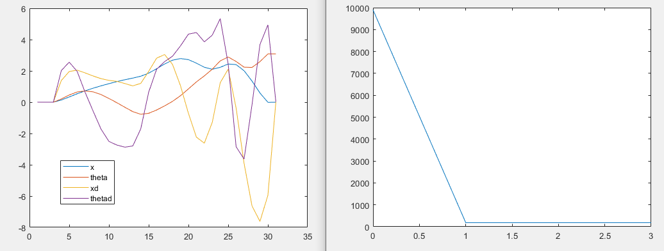
Ilqr+ Ltv cartpole + ARMA
C=I, qx=qu=1

Slide 7
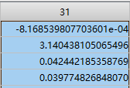
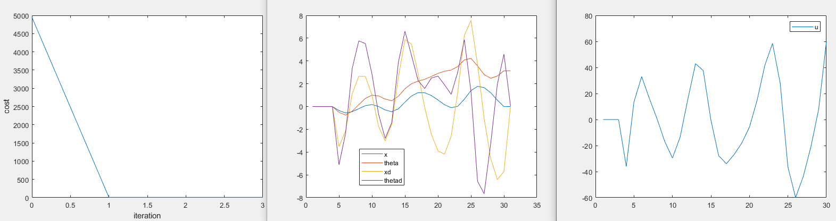
Ilqr+ Ltv cartpole + ARMA
C=pos only, qx=qu=2

Slide 8
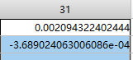
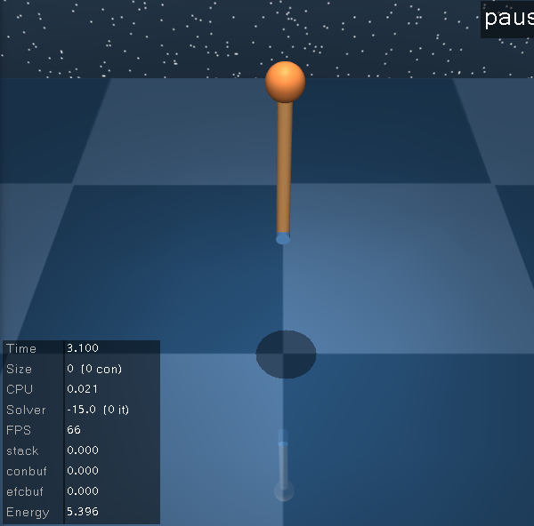
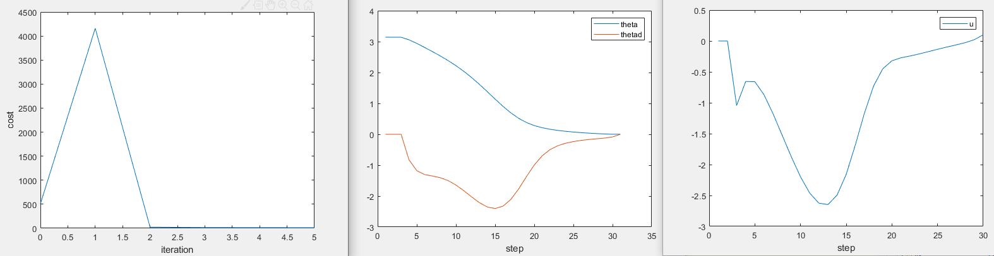
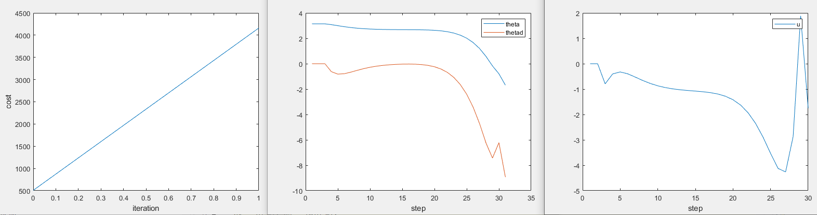
Ilqr+ pendulum+ ARMA
C=I, qx=qu=1

Slide 9
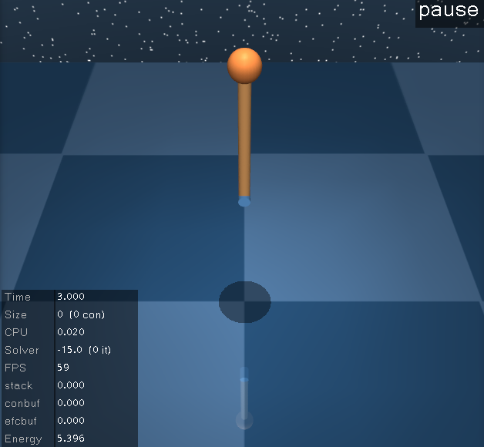
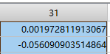
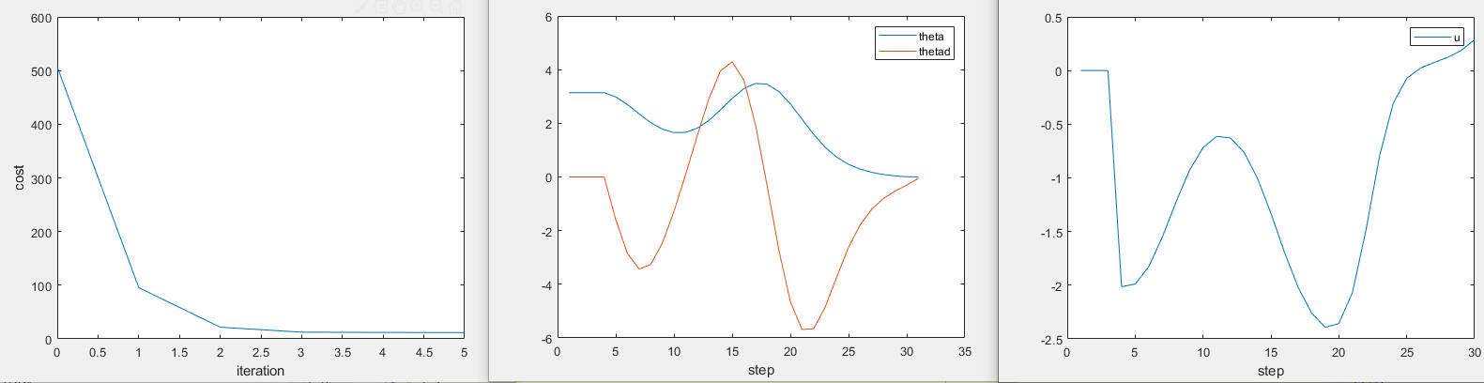
Ilqr+ pendulum+ ARMA
C=pos only, qx=qu=2

Slide 10
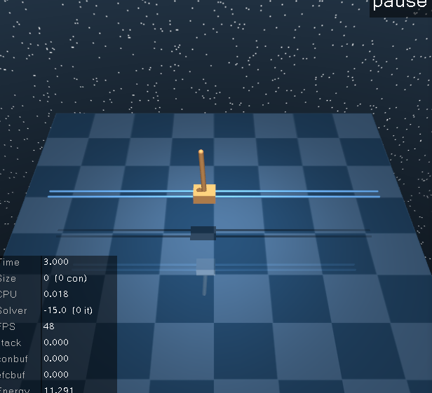
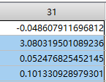
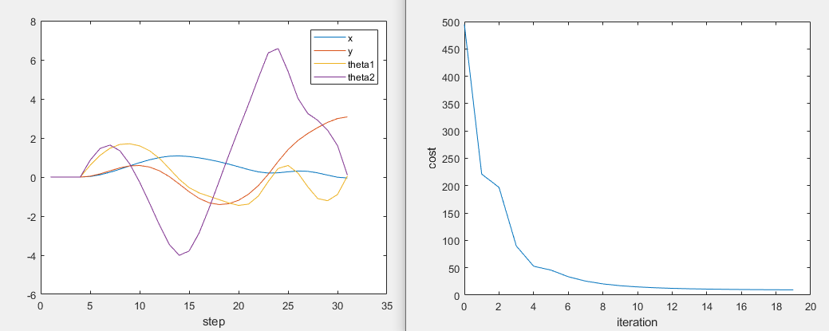
Ilqr+ cartpole+ ARMA
C=I, qx=qu=1

Slide 11
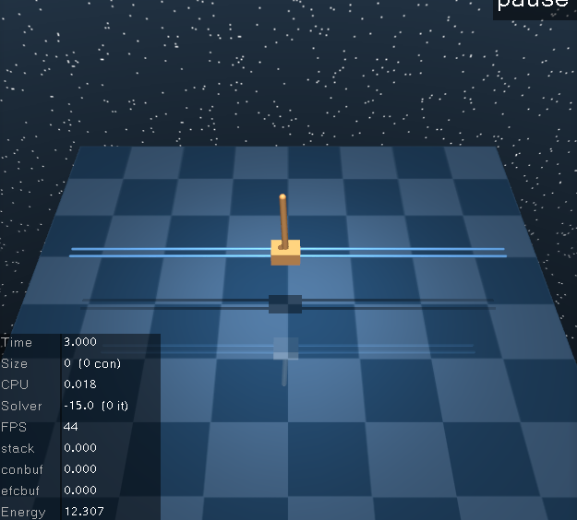
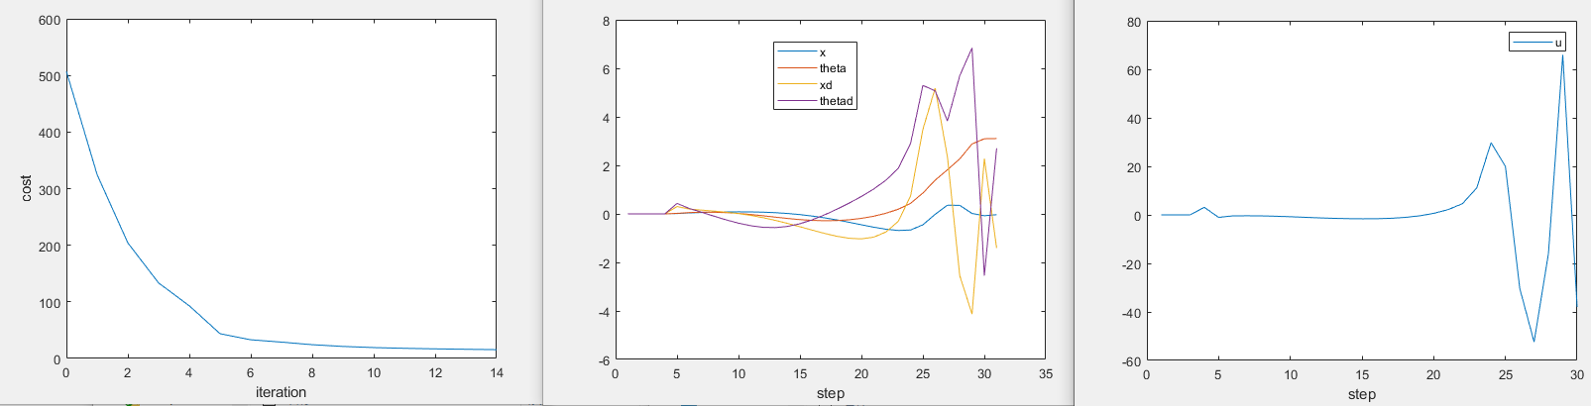
Ilqr+ cartpole+ ARMA
C=pos only, qx=qu=2

Slide 12
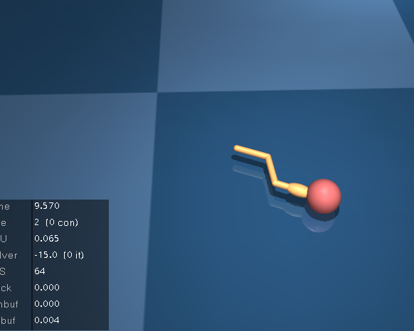
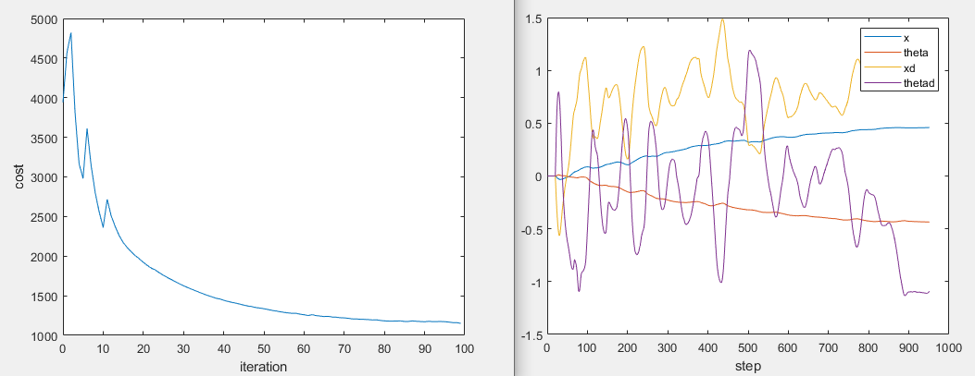
Ilqr+ swimmer3+ ARMA
C=I, qx=qu=1

Slide 13
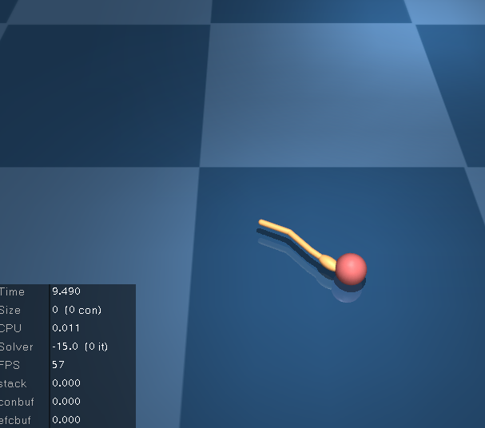
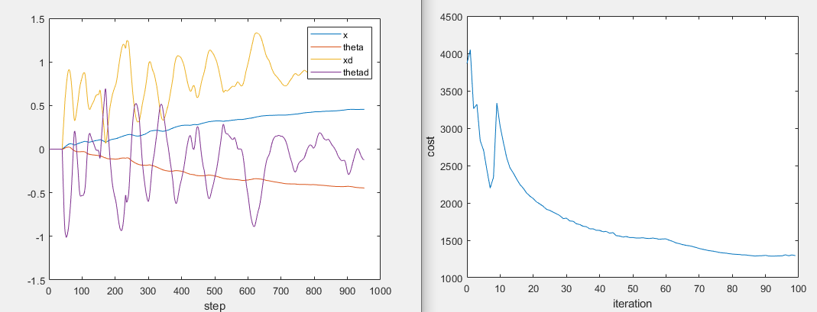
Ilqr+ swimmer3+ ARMA
Pos only, qx=qu=2

Slide 14
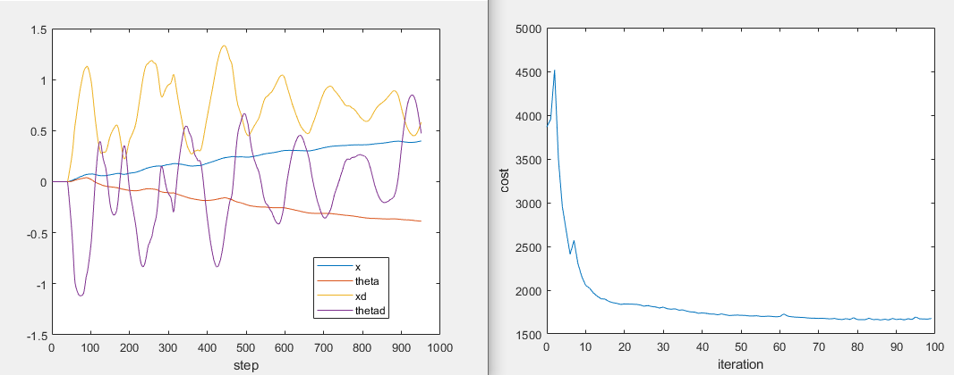
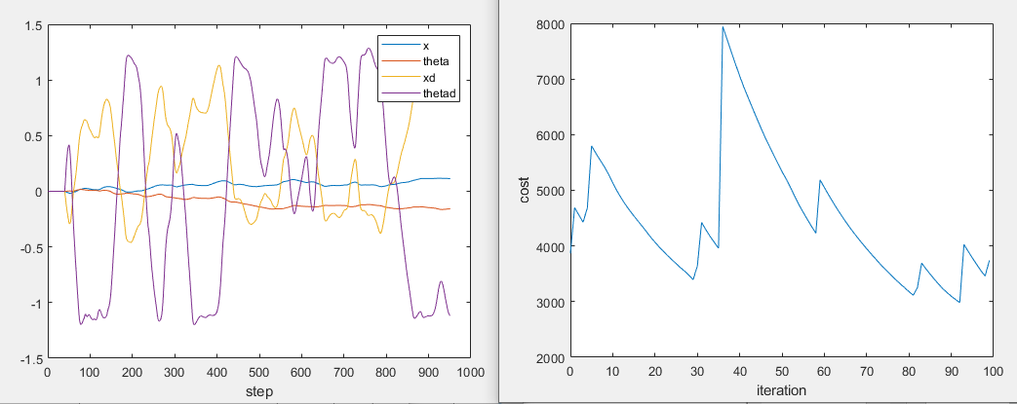
swimmer3
Alpha=0.9*alpha
Line search IROS12 paper

Slide 15
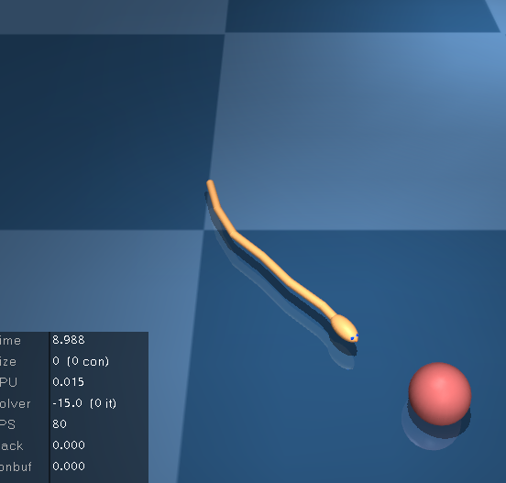
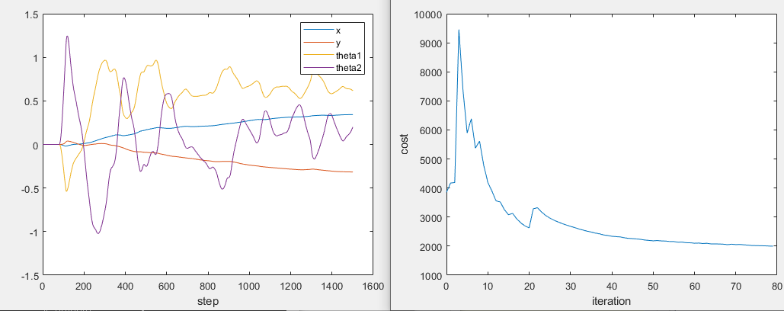
Ilqr+ swimmer6+ ARMA
C=I, qx=qu=1，no batching

Slide 16
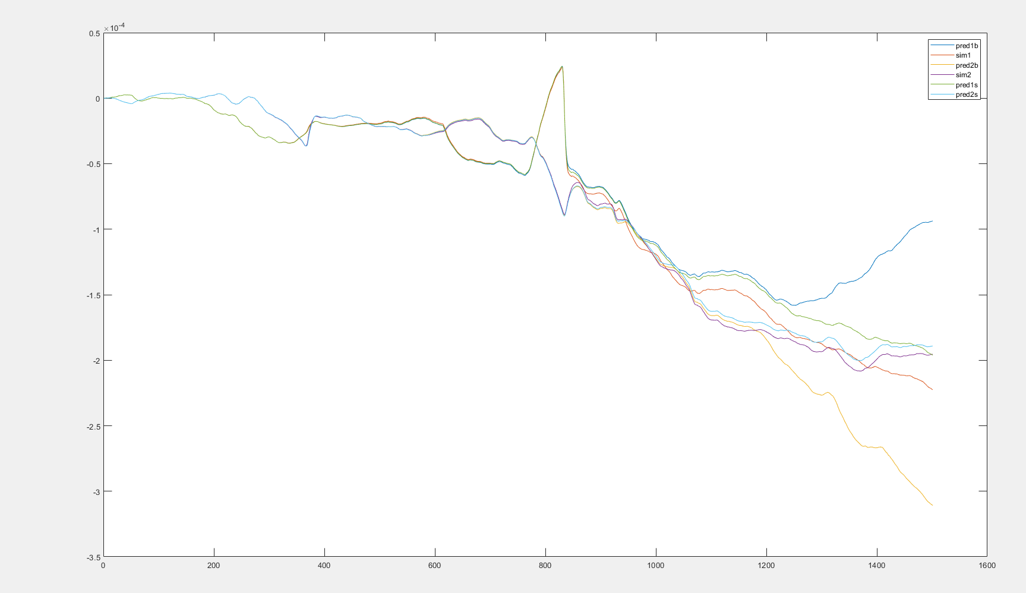
Batch=4
Skip 40 steps

Slide 17
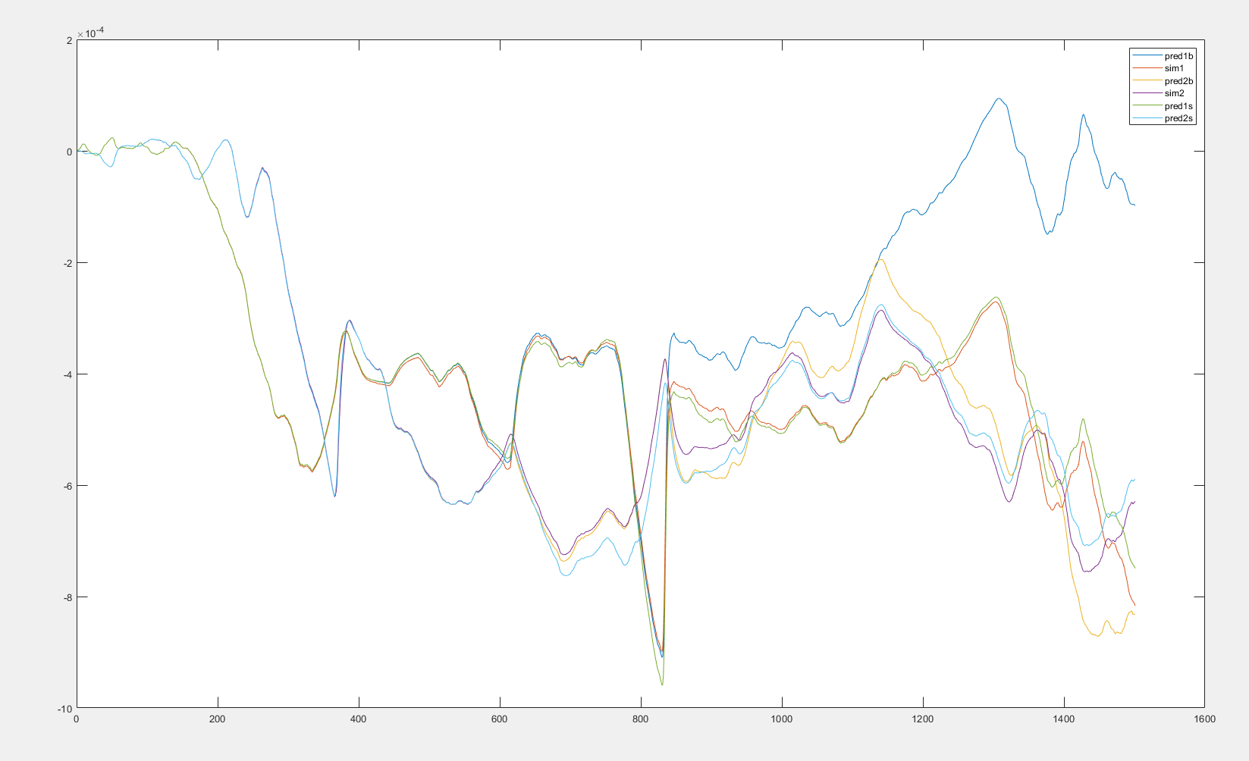
Batch=4
Skip 40 steps

Slide 18
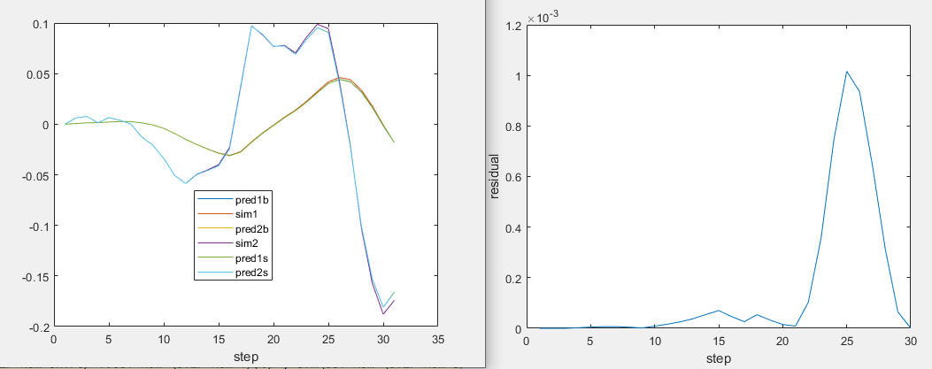
Pendulum+arma+single batch residual

Slide 19
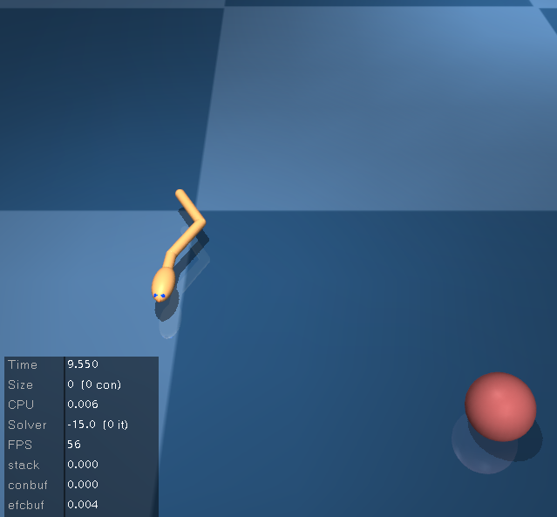
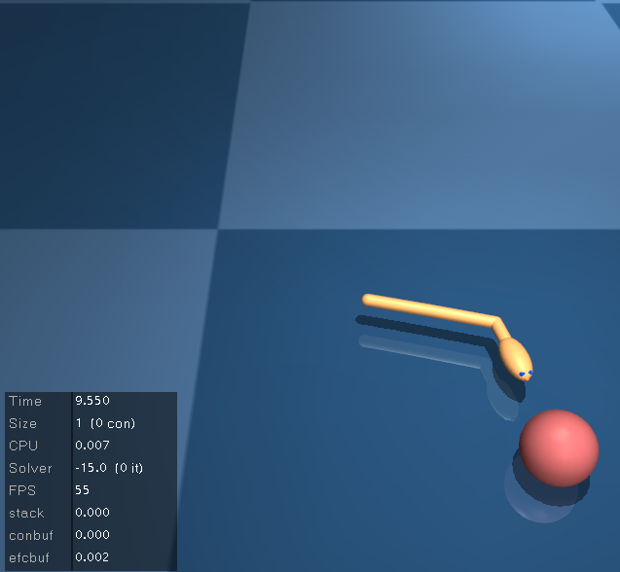
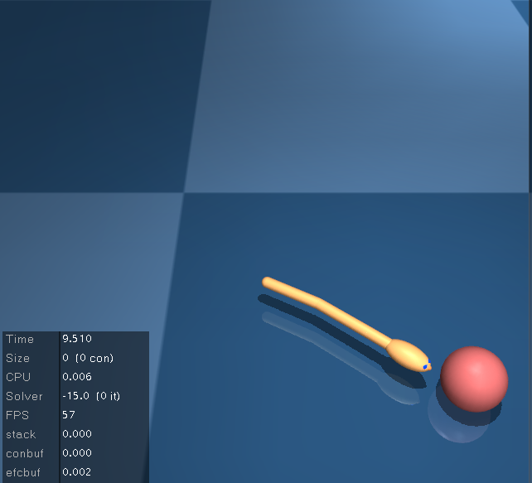
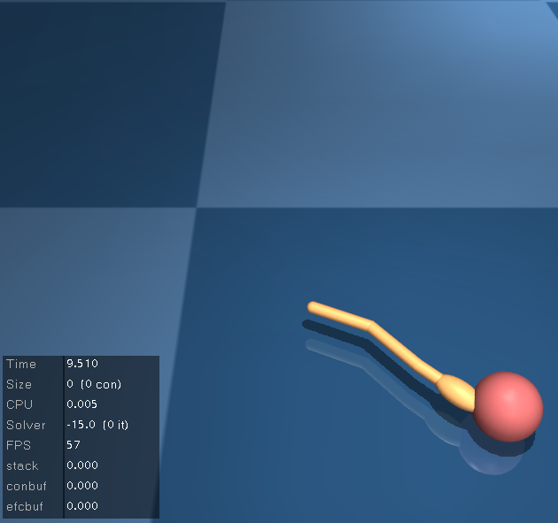
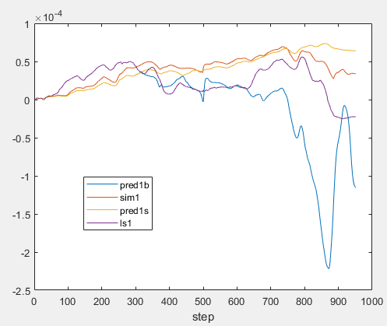
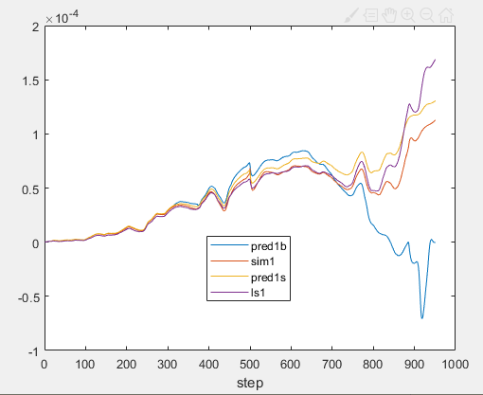
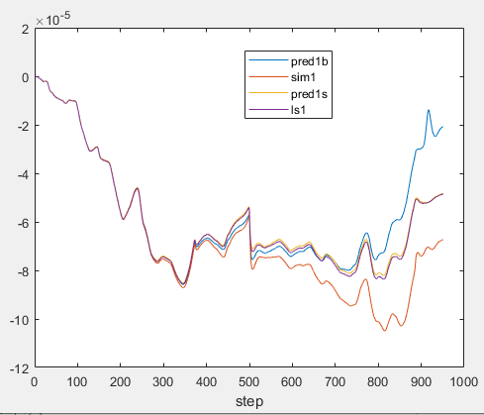
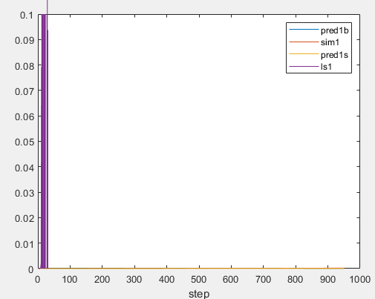
ID Noise=10% umax
ID Noise=1% umax
ID Noise=0.1% umax
ID Noise=0.01% umax
Test Noise=0.01% umax
100 rollouts
LS fails, single, batch similar

Slide 20



Test Noise=0.1% umax
100 rollouts
ID Noise=10% umax
Noise=1% umax
Noise=0.1% umax
Noise=0.01% umax

Slide 21
D2C 2.0 key settings
Initial guess
D2C2.0 training fails (error) without initial guess(s3,s6)
Matlab version (LS) converges but descents much slower
Add random noise as initial guess
2. Line search
IROS12 paper line search: fail to converge both python and matlab
alpha = alpha*0.9: can’t reach target but converge
D2C 2.0: works well, only need to decrease alpha in forward pass
3. Least square solver(matlab):
classic method: id perturbation var=e-6 can’t reach target, var= e-7,e-8 works well – need small perturbation
QR decomposition: var=e-6 works well, e-4 fails
4. Regularization never triggered in both
5. R should not be small
6. Need damping for tensegrity

Slide 22


Ilqr+ swimmer6+ LSID matlab
C=I, qx=qu=1，all parameters are the same as d2c 2.0

Slide 23





Increase perturbation for the first few steps

Slide 24


Ilqr+ swimmer6+ ARMAID matlab
C=I, qx=qu=1

Slide 25


Ilqr+ swimmer6+ ARMAID matlab
C=pos only, qx=qu=2

Slide 26




Umax=7
ID Noise=10% umax
ID Noise=1% umax
Test Noise=1% umax
100 rollouts

Slide 27


Add control truncation in ARMA id perturbation
Add control truncation in ARMA id perturbation and prediction perturbation

Slide 28


Ilqr+ dbar3d+ ARMAID matlab
C=I, qx=qu=1
With control truncation

Slide 29


Ilqr+ dbar3d+ ARMAID matlab
C=pos only, qx=qu=2
With control truncation

Slide 30


Ilqr+ dbar3d+ ARMAID matlab
C=first 2 nodes pos only, qx=qu=2
With control truncation
Need more rollouts in the ARMA fitting
Ilqr+ dbar3d+ ARMAID matlab
C=first 2 nodes pos only, qx=qu=3
With control truncation

Slide 31


Ilqr+ t1d1_3d+ ARMAID matlab
C=I, qx=qu=1
With control truncation

Slide 32


Ilqr+ t1d1_3d+ ARMAID matlab
C=I, qx=qu=1
With proposed control limit

Slide 33


Ilqr+ t1d1_3d+ ARMAID matlab
C=pos only, qx=qu=2
With control truncation

Slide 34


Ilqr+ t2d1_3d+ ARMAID matlab
C=I, qx=qu=1
With control truncation

Slide 35


Ilqr+ t2d1_3d+ ARMAID matlab
C=pos only, qx=qu=2
With control truncation

Slide 36


Ilqr+ t2d1_3d+ ARMAID matlab
C=8 node pos, qx=qu=3
With control truncation

Slide 37






Ilqr+ t2d1_3d+ ARMAID matlab
C=4 node pos, qx=qu=6
With control truncation
qx=qu=4
qx=qu=2

Slide 38


Ilqr+ t2d1_3d+ ARMAID matlab
C=1 top node pos, qx=qu=2
With control truncation

Slide 39


Ilqr+t2d1_3d+ARMAID matlab
C=8 node pos, qx=qu=3
With control truncation, control tension
+++damping!!!
Use the tension and hook’s law to generate the rest lengths at each timestep, then control the rest length. Worked.

Slide 40


Ilqr+ dbar3d+ ARMAID matlab
C=I, qx=qu=1
With proposed control limit+prestress
0 stiffness

Slide 41


Ilqr+ swimmer15+ ARMAID matlab
C=I, qx=qu=1

Slide 42


Ilqr+ swimmer15+ ARMAID matlab
C=pos only, qx=qu=2

Slide 43


Ilqr+ fish+ ARMAID matlab
C=I, qx=qu=1

Slide 44


Ilqr+ fish+ ARMAID matlab
C=pos only, qx=qu=2

Slide 45


Ilqr+ fish+ ARMAID matlab
C=xyz+q0+fin pos, qx=qu=2

Slide 46


Ilqr+ fish+ ARMAID matlab
C=xyz+q0, qx=qu=7

Slide 47
No slack strings
Use prestress as initial guess + none zero tension limit(truncation)
Current setup
Tendon stiffness: 0
Control variable: tension
Issue
Simulation sensitive to inaccuracy (not stable equilibrium)
Need stiffness
Directly add tendon stiffness in the mujoco model
Or simulate the tension from elongation in software
Simulation stable (stable equilibrium)
Energy waste in ilqr result (strings connected to the floor)
Ilqr result fails to reach target (wave up and down)
Solution 1
Put some stiffness in the mujoco model
Apply prestress tension calculated from matlab
Wait until it becomes stable (enter equilibrium point)
Calculate the tension from elongation (stiffness*(current length-initial length))
Initial guess is prestress + tension from elongation
Remove the stiffness in mujoco model and do ilqr

Slide 48



Add stiffness in the model and control the rest length
Simulation stable (stable equilibrium)
No energy waste from stiffness
Solution 2
Add tendon stiffness in the mujoco model
Change control variable to rest length
Transform prestress tension to rest length in matlab and use as initial guess for ilqr
Truncate rest length < current length (tendon is a spring)
Change control cost to constrain rest length-initial rest length
New t1d1_3d model
Stable with initial prestress
ARMAID with u = rest length

Slide 49


Ilqr+ dbar3d+ ARMAID matlab
C=I, qx=qu=1
With control truncation+prestress
Control rest length (applied solution 2)
Stiffness=100

Slide 50


Ilqr+ t1d1_3d+ ARMAID matlab
C=I, qx=qu=1
With control truncation+prestress
Control rest length (applied solution 2)
Stiffness=100

Slide 51


Slide 52


Slide 53




s6
cartpole
Small miu
miu = 100
miu = 10^6

Slide 54




cartpole
Miu=0
Miu=1000
Miu=20
Miu=50

Slide 55

Cartpole
Increase R to 1, miu=10
retrain

Slide 56


Nominal: R=20, umax=10
DDP:R=0.05 miu=10 otherwise umax is too large

Slide 57


cartpole
Miu=0 R=20 train+DDP
2000 rollouts

Slide 58


cartpole
pendulum

Slide 59



Obstacle func: 1000^(-(x-2)^2+2)+1000^(-(x+2)^2+2)
cartpole
Miu=0 R=20 train+DDP
100 rollouts for jacobian estimation, 1e-4
2000 rollouts for hessian estimation, 1e1

Slide 60




S6 miu=0 R = 0.005
miu=100 R = 100
DDP:miu=100 R = 100 ilqr:miu=0,R=0.005
DDP:miu=100 R = 100 ilqr:miu=100,R=100

Slide 61


s6
DDP:miu=1000 R = 0.005 idnoisestd=0.01 or 0.00001 100000rollouts
DDP has much higher variance and mean than lqr

Slide 62



Miu=100 R=10
Miu=1000 R=20
Fish
DDP:Miu=1000 R=20
ILQR:miu=0 R=0.05

Slide 63



Fish
Miu=1000 R=20
X-axis % of umax=5.3
Ddp increased miu and R
Ilqr original small miu and R

Slide 64


pendulum
miu=0,R=0.01,2000rollouts
miu=20,R=0.01,2000rollouts

Slide 65

pendulum
DDP:miu=0,R=0.01,2000rollouts

Slide 66




10 rollouts for fxx id
50 rollouts for fxx id
100 rollouts for fxx id
1000 rollouts for fxx id
Need O((ns+nu)^2) rollouts
Cartpole
ns=4, nu=1
Tested under 10% umax noise

Slide 67




S6 ns=16, nu=5 Tested under 10%umax noise
Id noise std=0.01
400 rollouts for fxx id
Residual e-3, max cond=628
2000 rollouts for fxx id
Residual e-3, max cond=63
5000 rollouts for fxx id
Residual e-3, max cond=41
20000 rollouts for fxx id
Residual e-3, max cond=30

Slide 68


5000 rollouts for fxx id
Residual e-18, max cond=41
Idnoise std e-5
5000 rollouts for fxx id
Residual e-6, max cond=41
Idnoise std e-3
5000 rollouts for fxx id
Residual 0.7, max cond=41
Idnoise std e-1
Tested under 10%umax noise

Slide 69








Cartpole 1000 rollouts
1% noise
10% noise
30% noise
100% noise
Swimmer6 50000 rollouts
ns=16，nu=5
1% noise
10% noise
30% noise
100% noise

Slide 70









pendulum
Fx id perturbation e-4, 50 rollouts
Fxx id 2000 rollouts
Fxx id perturbation e-10
Residual e-30, mcond 6
Fxx id perturbation e-6
Residual e-30, mcond 6
Fxx id perturbation e-3
Residual e-24, mcond 6
Fxx id perturbation e-1
Residual 11, mcond 6
Quu not pd
Quu not pd
50%
200%

Slide 71








pendulum
Fx id perturbation e-4, 50 rollouts
Fxx id 2000 rollouts
Fxx id perturbation e0
Residual 15, mcond 6
Fxx id perturbation e1
Residual 17, mcond 6
Fxx id perturbation e2
Residual 18, mcond 6
Quu not pd
50%
200%

Slide 72










Cartpole
Fx id perturbation e-4, 100 rollouts
Fxx id 2000 rollouts
Fxx id perturbation e-8
Residual e-30, mcond 9
Fxx id perturbation e-5
Residual e-30, mcond 10
Fxx id perturbation e-3
Residual e-24, mcond 9
Fxx id perturbation e-1
Residual e-8, mcond 11
Quu not pd
10%
70%

Slide 73










Cartpole
Fx id perturbation e-4, 100 rollouts
Fxx id 2000 rollouts
Fxx id perturbation e0
Residual 0.2, mcond 9
Fxx id perturbation e1
Residual 259, mcond 9
Fxx id perturbation e2
Residual 36000, mcond 9
Fxx id perturbation e3
Residual 36000, mcond 9
Quu not pd
10%
70%

Slide 74


No reset
Miu=100

Slide 75

Code&data in GitHub

Slide 76


Closedloop implementation
TPFC – with Rt,xx in Pt propagation, no Rt,xu in the K calculation
TLQR – TPFC equations without hessian
ILQG – DDP without hessian
MPC – no code
With obstacles

Slide 77


Closedloop implementation
TPFC – with Rt,xx in Pt propagation, no Rt,xu in the K calculation
TLQR – TPFC equations without hessian
ILQG – DDP without hessian
MPC – no code
No obstacles

Slide 78

Code&data in hard drive

Slide 79



Code in hard drive
Run with obstacles
Original cost in the code, different for TLQR, TPFC
Remove values greater than 1e8
Remove values greater than 1e6
Original

Slide 80



Code in hard drive
Run with obstacles
TPFC cost for TLQR,TPFC
Remove values greater than 1e8
Remove values greater than 1e6
Original

Slide 81



Code in hard drive
Run with obstacles
TLQR cost for TLQR,TPFC
Remove values greater than 1e8
Remove values greater than 1e6
Original

Slide 82



Code in hard drive
Original data
Remove values greater than 1e8
Remove values greater than 1e6
Original, same as first plot

Slide 83



Code in hard drive
Run without obstacles
Original cost in the code, different for TLQR, TPFC
Remove values greater than 1e8
Remove values greater than 1e6
Remove values greater than 1e5，reasonable data is in 1e4

Slide 84


Code in hard drive
Run without obstacle
TLQR cost for TLQR,TPFC
Remove values greater than 1e5
Original

Slide 85



Code in hard drive
Run without obstacles
TPFC cost for TLQR,TPFC
Remove values greater than 1e8
Remove values greater than 1e6
Original

Slide 86


Code in hard drive, Run without obstacles, 50 runs
Original cost in the code, different for TLQR, TPFC
Remove outliers(max(x, y)<10), noise=0.075
TPFC
TLQR

Slide 87




Code in hard drive, Run without obstacles, 50 runs
Original cost in the code, different for TLQR, TPFC
Remove outliers(max(x, y)<10), noise=0.02
TPFC
TLQR
5x
5x

Slide 88


Code in hard drive, Run with obstacles, 100 runs
Original cost in the code, different for TLQR, TPFC
Remove outliers(max(x, y)<10), noise=0.005
TPFC
TLQR

Slide 89




Code in hard drive, Run with obstacles, 100 runs
Original cost in the code, different for TLQR, TPFC
Remove outliers(max(x, y)<10), noise=0.01
TPFC
TLQR
5x
5x

Slide 90


Code in hard drive, Run with obstacles, 100 runs
Original cost in the code, different for TLQR, TPFC
Remove outliers(max(x, y)<10), noise=0.02
TPFC
TLQR

Slide 91






Code in hard drive, Run with obstacles, 100 runs
Original cost in the code, different for TLQR, TPFC
Remove outliers(max(x, y)<10), noise=0.035
TPFC
1x
TLQR
1x
5x
5x

Slide 92


Code in hard drive, Run with obstacles, 100 runs
Original cost in the code, different for TLQR, TPFC
Remove outliers(max(x, y)<10), noise=0.075
TPFC
TLQR

Slide 93




Code in hard drive, Run with obstacles, 100 runs
Original cost in the code, different for TLQR, TPFC
Remove outliers(max(x, y)<10), noise=0.095
TLQR
TPFC
1x
1x

Slide 94



Code in hard drive
Run with larger obstacles
Original cost in the code, different for TLQR, TPFC
Original data
Remove > e8

Slide 95




4 center node pos+z of balance bars
4 center node pos+balance bar end node pos
4 center node pos in cost

Slide 96



T2d1 folding， string damping=1，xyz of all the nodes

Slide 97



T2d1 folding， string damping=1，xyz of all the nodes
0.01s, 300steps

Slide 98


Slide 99

Monte Carlo Tree Search
Algorithm(UCT)
Select – start from current situation, search along the tree according to UCB
Expand – if next search node is unseen, add node
Simulate – simulate to game end with a random policy
Backpropagate – from the leaf node, update all parent nodes
Repeat, then choose the best move from the current situation
Current situation
1/2
2/3
0/2
1/1
0/1
2/2
0/1
2/2
+
0/0
UCT: Upper Confidence Bound for tree
UCB = $\frac{w}{n}+c\sqrt{\frac{\ln{N}}{n}}$
$w$: number of wins from this node
$n$: number of games from this node
$N$: number of games from its parent node
$c$: exploration parameter
In step 1, select max(UCB) node.
Used on CrazyStone

Slide 100
AlphaGo
Add value function to each node
Use convolution neural nets to represent value function of all nodes and the policy to choose action (value net + policy net)
Use weighted average of value function and w/n from random policy simulation as the new reward for the node to do UCB
AlphaZero
Use one cnn to in place of value net and policy net

Slide 101



Spring Loaded Inverted Pendulum
Basic SLIP model
Angular and Radial SLIP model(ARSLIP)
Asymmetric SLIP model(ASLIP)
Energy-Stabilized SLIP(ES-SLIP)
Double SLIP model(DSLIP) for bipedal robot

Slide 102



Slip cheetah
T=3s,dt=0.001s
Gradient descent nominal
Ilqr didn’t converge
Arma id check
Lqr check

Slide 103


Slip cheetah
T=2s,dt=0.001s
Increase damping+stiffness+inertia
Gradient descent nominal
Ilqr didn’t converge
Arma id check
Lqr check

Slide 104


T2d1 folding,7 iteration,266s

Slide 105

T2d1 folding,7 iteration,266s

Slide 106

Training reliability

Slide 107

T2d1 fold, pos only
266s 7ite
Q=qu=2

Slide 108


T2d1 fold, pos only
266s 7ite
Q=qu=2

Slide 109



T2d1 bend, 8 node pos only
1124s 40ite
Q=qu=3
10% measurement noise

Slide 110

T2d1 bend, 8 node pos only
1124s 40ite
Q=qu=3

Slide 111


Fish ilqr,fin pos + xyz + q0
2365s, 200ite
Q=qu=2

Slide 112


Fish ilqr,fin pos + xyz + q0
2365s, 200ite
Q=qu=2

Slide 113


Ilqr+ swimmer15+ ARMAID matlab
C=xy+8 angle, qx=qu=2
100ite, 2081s

Slide 114


Ilqr+ swimmer15+ ARMAID matlab
C=xy+8 angle, qx=qu=2
100ite, 2081s

Slide 115


cartpole
Pos only, qx=qu=2
40ite, 1s

Slide 116


Slide 117


Pendulum noiseless mpc
U starts with random guess
U starts with previous nominal

Slide 118


Pendulum mpc with process noise std=0.002
U starts with random guess
U starts with previous nominal

Slide 119


Pendulum mpc with process noise std=0.01
U starts with random guess
U starts with previous nominal

Slide 120


[z(t),z(t-1),u(t)],z=angle
original
240000 steps 1335s
240000 steps 1324s

Slide 121


Pendulum noiseless mpc – full state
Noiseless
State noise std=0.01

Slide 122


Pendulum noiseless mpc – full state
Noiseless, init with ilqr nominal control
State noise std=0.01

Slide 123

Pendulum noiseless mpc – full state
State noise std=0.002

Slide 124




cartpole
State noise std=0
State noise std=0.001
State noise std=0.02

Slide 125

Need quadratic cost and dynamics linear in control to have unique solution
Increase rollout number for arma fitting
More iterations(update convergence criteria)
Larger control cost

Slide 126
State perturbation dx at initial step must be very small, s6 – 0.0001
If use z>0.01, cost will surely descend, but line search alpha could be too small trying to make z > 0.01,step could get stuck, z>0 is better
Stopping criterial can be final dist < threshold
Alpha should not decrease fast, or update will be small and feedback effect will be small

Slide 127

Cartpole
Umax = 12 for both
D2C-MPC 100 runs
DDPG 500 runs

Slide 128

S6 Terminal state error = 0.015

Slide 129


Swimmer6
Umax = 20 for DDPG
Umax = 5 for D2C(LQG)
200 runs
Better nominal trajectory by ilqr-arma
Feedback u limited to 20, no unstable simulations

Slide 130

Swimmer6
Umax = 20 for DDPG
Umax = 6 for D2C(LQG)
200 runs for DDPG,D2C
5 runs for D2C replan

Slide 131

Fish
200 runs

Slide 132



Slide 133


Slide 134


Pendulum
% of umax
Process noise in control
Process noise in control and state

Slide 135


Pendulum closedloop testing
For policies trained and tested with process noise in control

Slide 136


0.6u
0.1su

Slide 137

Pendulum
% of umax
Both control and state noise

Slide 138


Pendulum closedloop testing
For policies trained and tested with process noise in control

Slide 139


Pendulum closedloop testing
For policies trained and tested with process noise in control

Slide 140


Trained and tested with both state and control noise
Can swing up

Slide 141


Cartpole
% of umax
Process noise in control
Process noise in control and state

Slide 142

Cartpole closedloop testing
For policies trained with process noise in control

Slide 143


Cartpole closedloop testing
For policies trained and tested with process noise in control

Slide 144

Trained and tested with both state and control noise
Can not swing up
Can swing up but further from target state
Can swing up

Slide 145


Swimmer3
% of umax
Process noise in control
Process noise in control and state

Slide 146


S3 closedloop testing
For policies trained and tested with process noise in control
S3 closedloop testing
For policies trained and tested with process noise in control and state

Slide 147


Pendulum exploration noise

Slide 148


Pendulum exploration noise

Slide 149

Cartpole exploration noise

Slide 150


Cartpole exploration noise

Slide 151


T2d1 training with 10^-5 noise

Slide 152
Benefits of tensegrity
Mass efficiency
Adjustable stiffness
Axial load on bars only
Energy absorption
Large deformation

Slide 153


Tested with noise in u
Cartpole
Process noise in control
Exploration noise in control
Performance threshold
Performance threshold
30
Threshold is determined by whether it is close to the swingup pos

Slide 154

Trained and tested with noise in state and control
Cartpole
Performance threshold
0.8
1.4
2.7

Slide 155


Tested with noise in u
Pendulum
Process noise in control
Exploration noise in control
Performance threshold
Performance threshold
50
45
Threshold is determined by 30 degrees and 40 degrees/sec error

Slide 156

Trained and tested with noise in state and control
Pendulum
Performance threshold
4.5
5.5

Slide 157


Swimmer3
Process noise in control
Process noise in control and state
Performance threshold
Performance threshold
52
Threshold is determined by whether it swims in the ball (r=0.05)

Slide 158

Convergence comparison
ILQR vs. SQP on pendulum
Ilqr implemented in matlab with least square id
Sqp implemented using fmincon

Slide 159

Convergence comparison
ILQR vs. SQP on pendulum
State trajectory
ilqr
sqp

Slide 160

Convergence comparison
ILQR vs. SQP on pendulum
State trajectory
ilqr

Slide 161

u trajectory
Convergence comparison
ILQR vs. SQP on pendulum
ilqr
sqp

Slide 162




Fmincon – all algorithms found local minimum
sqp
Sqp-legacy
Interior point
Active-set

Slide 163


T2d1 rework
Improvements
Change control to restlength
Axisymmetric model with group control
Joint limit set to folded position
Change control cost to string speed?
Previous model
New model

Slide 164


T2d1 - ddpg

Slide 165


Ilqr training on pendulum with no feedback
Nominal term and feedback term, K not small, line search cannot find descending stepsize, alpha almost 0
Wrong direction without feedback?

Slide 166




0.5*K,50 iterations
pendulum

Slide 167


0.5*K, first 10 iterations
pendulum

Slide 168




With feedback, 1*K
pendulum
3 iterations
50 iterations

Slide 169


Sqp state traj ite
Linear system (pendulum linearized at top pos)

Slide 170

Sqp control traj ite
Linear system (pendulum linearized at top pos)

Slide 171

Ilqr alpha=1
Linear system (pendulum linearized at top pos)

Slide 172

Ilqr alpha=0.3
Linear system (pendulum linearized at top pos)
State traj ite
Control traj ite

Slide 173





pendulum
AB matrix almost matches
Matrix inversion
QR decomposition

Slide 174





pendulum
AB matrix almost matches
Matrix inversion
QR decomposition

Slide 175





Cartpole
AB matrix almost matches
Matrix inversion
QR decomposition

Slide 176






Cartpole
AB matrix almost matches
Matrix inversion
QR decomposition

Slide 177





Cartpole
AB matrix almost matches
Matrix inversion
QR decomposition

Slide 178





S3
AB matrix almost matches
Matrix inversion
QR decomposition

Slide 179






S3
AB matrix almost matches
Matrix inversion
Matrix inversion

Slide 180






S15
AB matrix almost matches
Matrix inversion
Matrix inversion

Slide 181

Cartpole full obsv, no vel in cost
Same pos cost
Arma-ilqr for all cases

Slide 182

Cartpole pos only, no x(t+1)-x(t) in cost
Same pos cost

Slide 183

Cartpole full obsv, with vel in cost
Same pos and vel cost

Slide 184

Cartpole pos only, with x(t+1)-x(t) in cost
Same pos and vel cost

Slide 185

Cartpole full obsv, no vel in cost

Slide 186

Cartpole pos only, no x(t+1)-x(t) in cost

Slide 187

Cartpole full obsv, with vel in cost

Slide 188

Cartpole pos only, with x(t+1)-x(t) in cost

Slide 189

Cartpole full obsv, no vel in cost

Slide 190

Cartpole pos only, no x(t+1)-x(t) in cost

Slide 191

Cartpole full obsv, with vel in cost

Slide 192

Cartpole pos only, with x(t+1)-x(t) in cost

Slide 193

S3 full obsv
Same cost without vel for both cases
617

Slide 194

S3 pos only
Same cost without vel for both cases
569

Slide 195

S3 full obsv

Slide 196

S3 pos only

Slide 197

S3 full obsv

Slide 198

S3 pos only

Slide 199


Sqp vs ilqr on cartpole, 0 initial guess
Terminal cost = 125 for both ilqr and sqp
Trajectory at last ite

Slide 200

ilqr on cartpole

Slide 201

ilqr on cartpole

Slide 202

sqp on cartpole

Slide 203

sqp on cartpole

Slide 204


Sqp vs ilqr on cartpole, initial guess = N(0,1)
Terminal cost = 125 for both ilqr and sqp

Slide 205








Ilqr&sqp initial guess = N(0,0) | Converged cost=125
Ilqr initial guess = N(0,3) | Converged cost=125
cartpole
Ilqr initial guess = N(0,5) | Converged cost=125
sqp initial guess = N(0,3) | Converged cost=125
sqp initial guess = N(0,5) | Converged cost=370
sqp initial guess = N(0,3) | Converged cost=430
All cases reached local minimum before stop
sqp initial guess = N(0,5) | Converged cost=125
sqp initial guess = N(0,3) | failed

Slide 206








Ilqr initial guess = N(0,0) | Converged cost=38
Ilqr initial guess = N(0,3) | Converged cost=38
pendulum
Ilqr initial guess = N(0,5) | Converged cost=38
sqp initial guess = N(0,3) | Converged cost=85
All cases reached local minimum before stop
sqp initial guess = N(0,5) | Converged cost=68
sqp initial guess = N(0,3) | Converged cost=69
sqp initial guess = N(0,5) | Converged cost=57
sqp initial guess = N(0,3) | Converged cost=89

Slide 207

sqp initial guess = N(0,0) | Converged cost=53

Slide 208

SQP acrobot

Slide 209
S15
AB matrix almost matches
Matrix inversion
Matrix inversion

